Slide 1

Sign Language App
Project Group ID ”29” Eman Tamam Mohamed : 162021069 Yasmeen Khaled Mohamed : 162021387 Arwa Mostafa Mohamed : 162021047
Dept. of Computer Science College of Computers and Information , Assiut University
1

Slide 2
Task Description
Task description
The sign language app is designed to translate ASL signs and gestures from both hands into meaningful words.
It provides a way to understand ASL sign language without the need to learn it.
The signs that the app translates include: busy, take care, I don't know, I am fine, who, chair, internet, I am tired, excuse me, and goodbye.
2

Slide 3
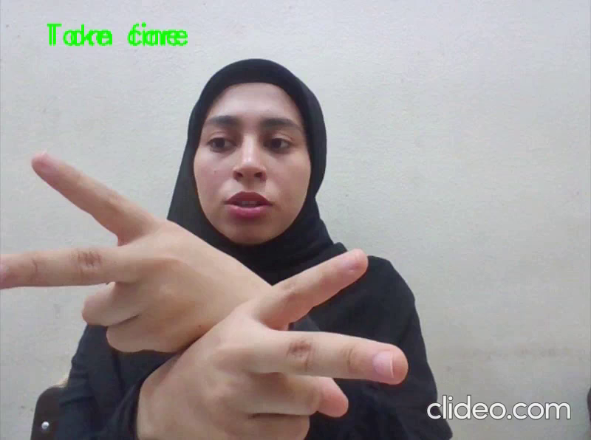
Demo
3
https://github.com/Eman288/Sign-Language

Slide 4
Contribution
Creating the dataset by getting the data from youtube.
defining the "load_dataset" function to load the data from our dataset.
Using a mediapipe solution ”Hand landmarks detection” to detect the landmarks.
Converting the labels of the dataset into numerical values.
Using our AI gym created model. we used the same layers then changed the number of classes for the output layer.
Setting the number of epochs to 200.
Saving the model to “model.keras” file.
Enable the use of webcam in the model.
Printing the result on the window, not the console.
4

Slide 5
Data
We collected the videos for our dataset from different sources, and then we built it.
The dataset consists of 10 folders, with each gesture having a labeled folder corresponding to the gesture.
Each folder contains 15-30 videos.
5

Slide 6
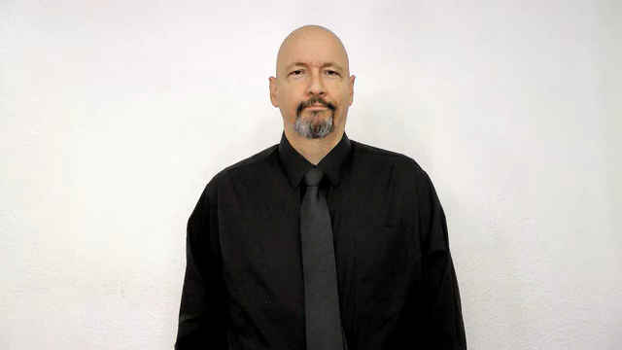
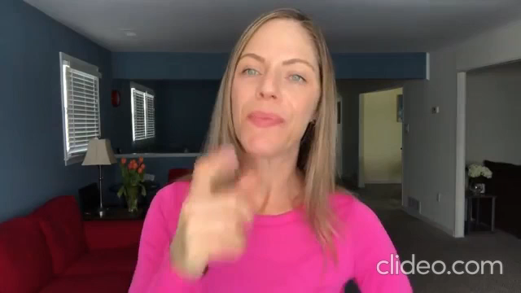
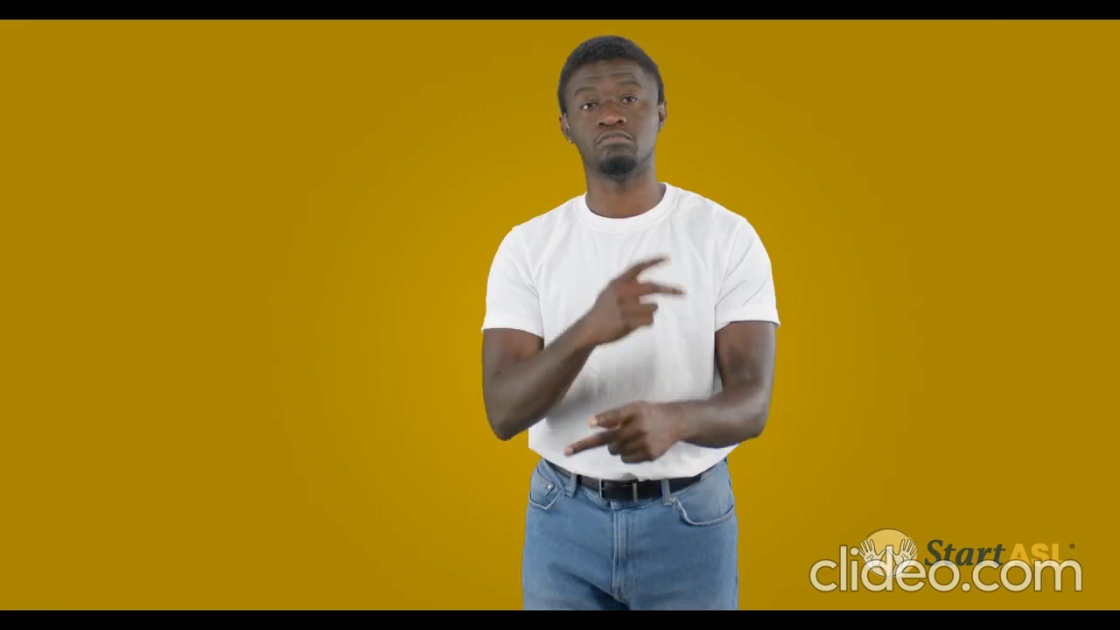
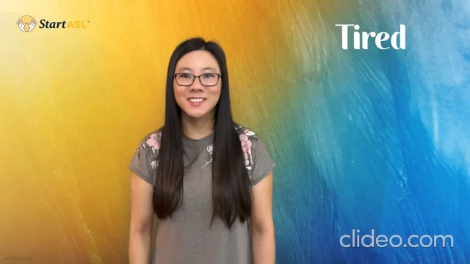
Data
Here are some samples of the data:-
I don’t know
Who
Take care
I am tired
6

Slide 7
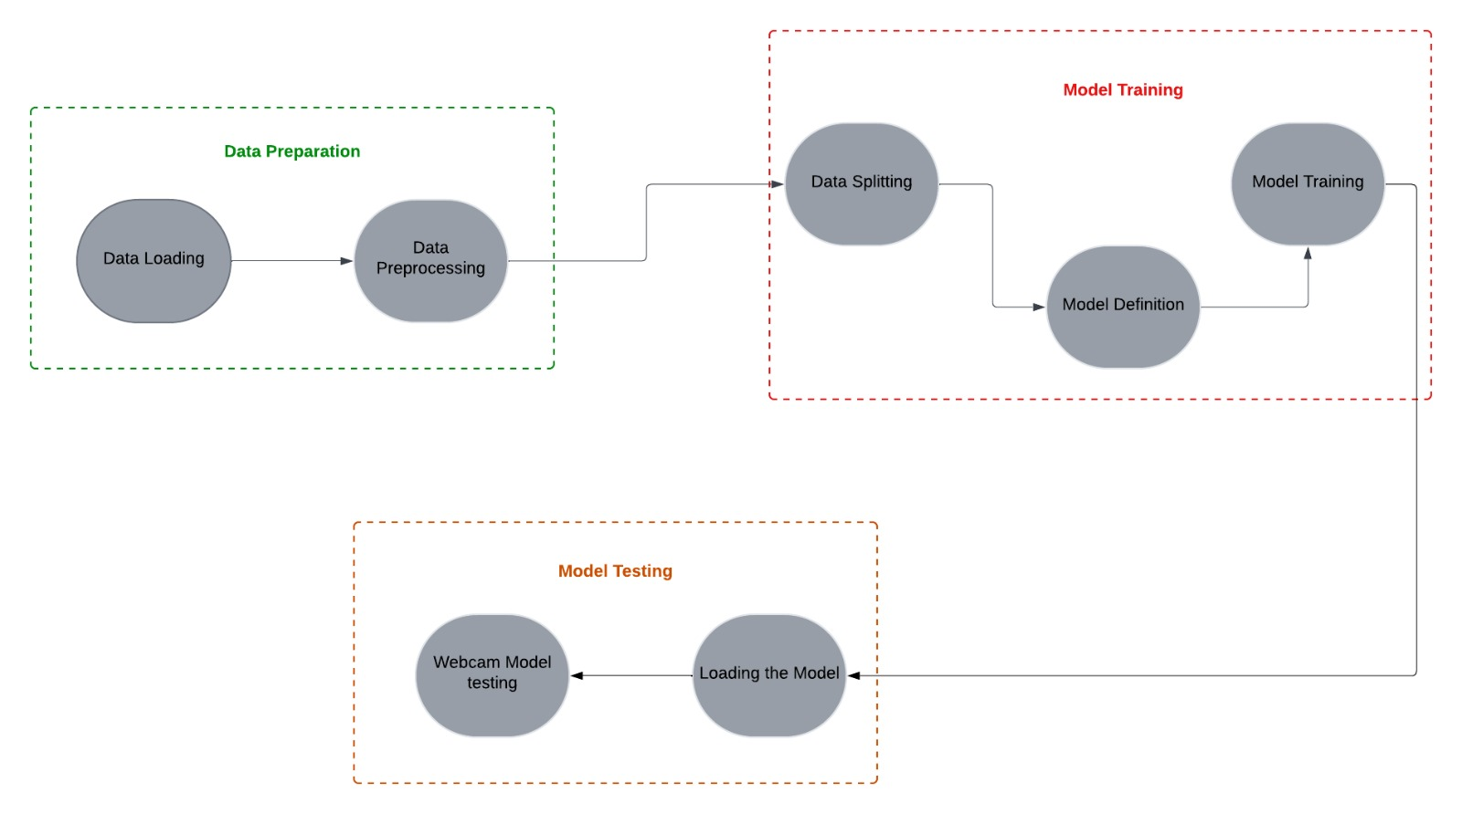
Project Architecture
Proect architecture
7
Figure 1: Project Architecture

Slide 8
Methods
The number of classes is 10
Using the Hand landmarks detection from mediapipe
The model is created with Tensorflow keras
This model consists of 9 layers:
1 Input, 2 Conv1D with “relu” activation function, 2 Maxpooling1D, 1 Flatten, 2 Dense one with “relu” activation function and the other with “softmax” activation function, 1 Dropout
The optimizer is 'adam', the loss function is ‘sparse_categorical_crossentropy', and the metrics is 'accuracy’
The epoch number is 200
8

Slide 9
Results
Results analysis
-Accuracy: 0.9983 (99.83%)
-Loss: 0.0037 (0.37%)
-Metrics: “accuracy”
9

Slide 10
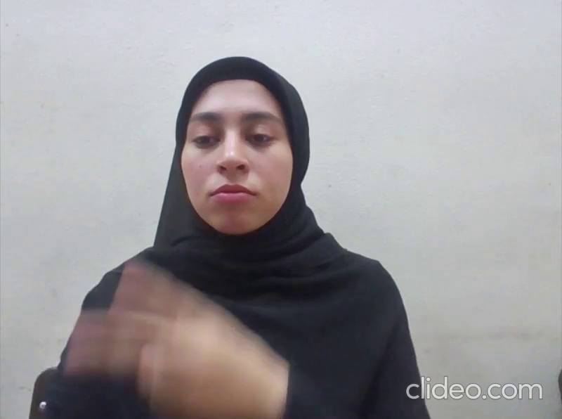
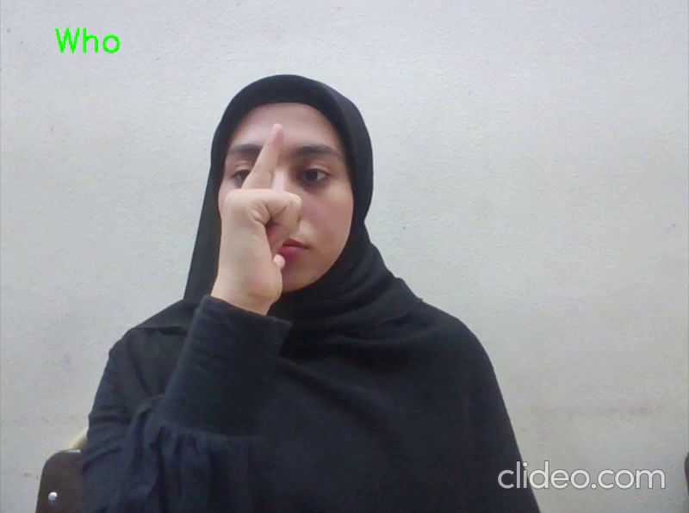
Results
Error Analysis:-
There is some kind of confusion in the “Take care” with "I am fine" signs and “Who” with "Internet" and "busy" signs
10
Takecare
Who

Slide 11
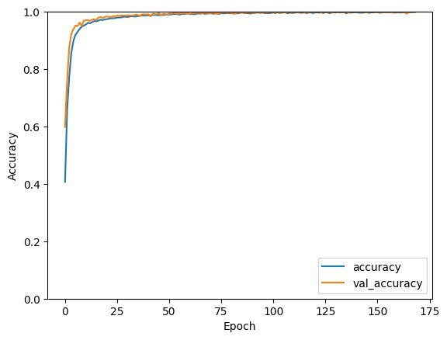
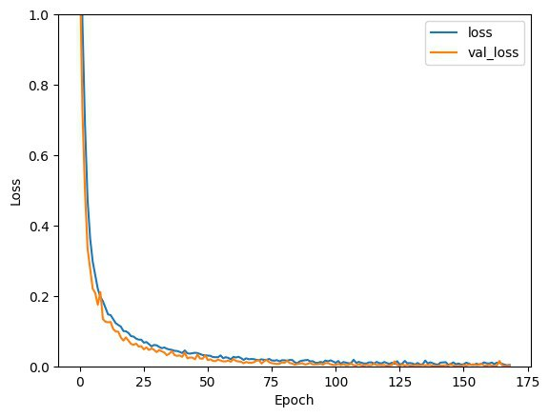
Results
Visualization for test and train data
11
Figure 2: Accuracy
Figure 3: Loss

Slide 12
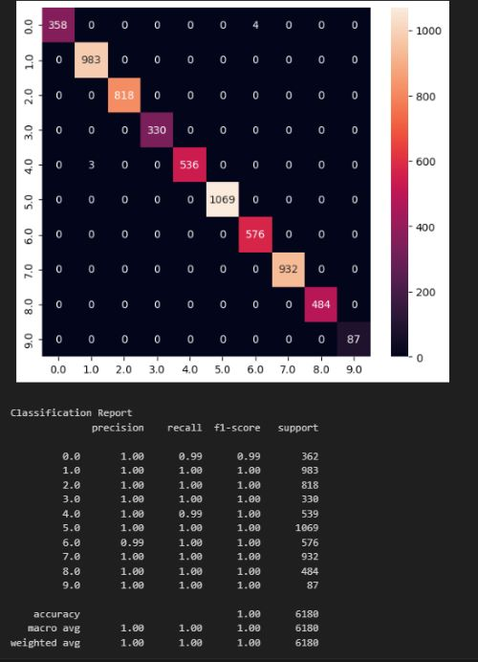
Results
Confusion matrix
12

